Slide 1
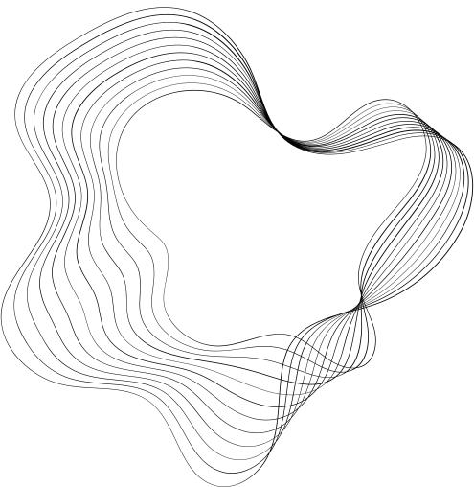

TRAFFIC
SIGN DETECTION
PRESENTING BY:
•PRASHANTH
•PRAJWAL U
•PRUTHVIRAJ

Slide 2

CONTENT
01
INTRODUCTION
02
OBJECTIVE
03
SYSTEM DESIGN
04
FLOWCHART
05
RESULT
06
CONCLUSION

Slide 3
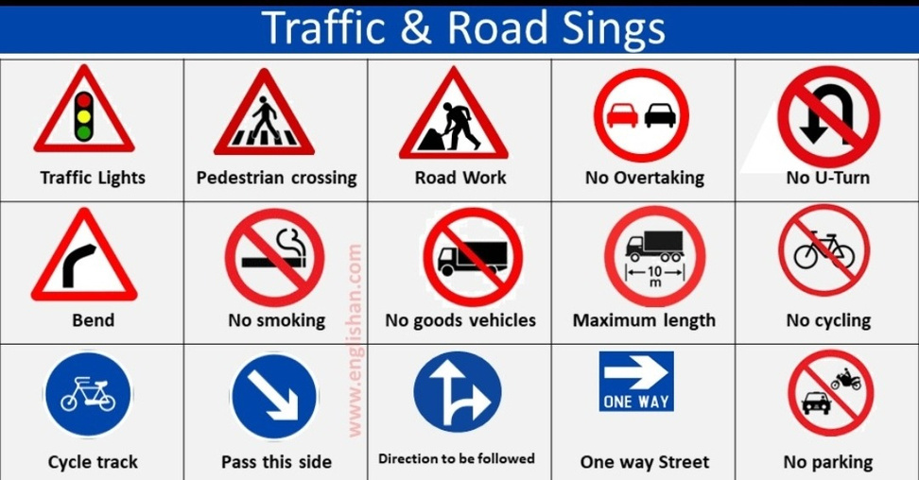

INTRODUCTION
TRAFFIC SIGN DETECTION
Traffic signs convey important information about traffic rules, regulations, warnings, and guidance, helping to ensure safe and orderly movement on the roads.
The primary goal of this project is to enhance road safety and assist drivers by providing real-time information about traffic signs. By accurately detecting and interpreting traffic signs, the system can alert drivers , warn them about potential hazards, guide them through complex intersections, and provide valuable information for navigation.

Slide 4

1. The traffic sign detection system uses cameras to capture images . 2. It analyzes the captured data to identify regions that may contain traffic signs. 3. The system extracts important visual features from these regions, such as color and shape. 4.Using machine learning algorithms, it classifies the detected regions into specific types of traffic signs. 5.The system then provides the output, indicating the type and location of the recognized traffic signs.
HOW TRAFFIC SIGN DETECTION WORKS

Slide 5
1.Develop a system that accurately detects and recognizes traffic signs in images . 2.Classify the detected traffic signs into specific types or categories. 3.Ensure real-time performance for immediate response and timely information to drivers. 4.Enhance road safety by providing drivers with critical information about traffic signs, speed limits, and potential hazards. 5.Contribute to driver assistance systems and the advancement of autonomous driving technology by enabling accurate traffic sign detection and interpretation.
OBJECTIVES

Slide 6

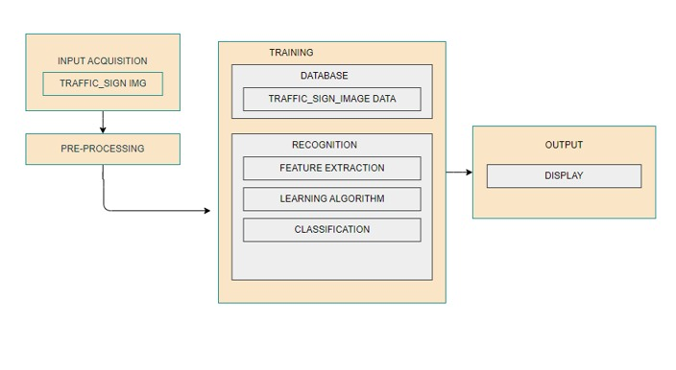
SYSTEM DESIGN
System Design process partitions the system into subsystems based on the requirements. It establishes overall system architecture and is concerned with identifying various components, specifying relationships among components, specifying software structure, maintaining a record of design decisions and providing a blueprint for the implementation phase.
Data Acquisition: Input traffic data will be acquired by the system using a camera interfaced to the microcomputer. Videos taken will be processed per frame by the system. Some testing processes will make use of traffic images to be stored in the microcomputer.
Pre-processing and Detection: The detection phase is composed of pre-processing, color-based segmentation, shape-based detection and object localization. Methods to be evaluated that use different filtering techniques in different color spaces are RGB Normalized Thresholding with Color Constancy Algorithm.

Slide 7
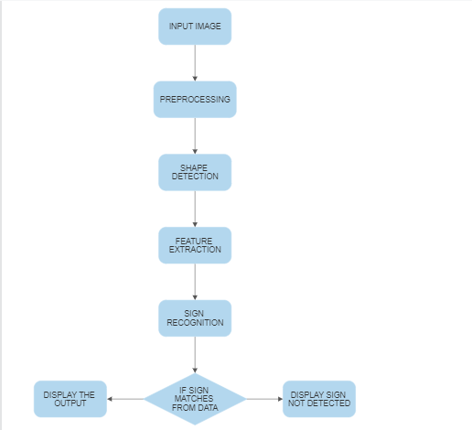
FLOWCHART
Input Image: The input image refers to the image or frame from a traffic scene that is being processed by a traffic sign detection system or algorithm. The input image serves as the primary input data for the detection process.
Preprocessing : Preprocess the dataset if necessary. This may involve resizing images, normalizing pixel values, or applying other transformations to ensure consistency and optimal input for the detection algorithm.
Feature Extraction : Feature extraction in traffic sign detection refers to the process of extracting relevant and discriminative features from the input images or video frames that can be used to distinguish and classify traffic signs. It involves transforming the raw pixel data into a set of meaningful representations that capture the distinctive characteristics.

Slide 8
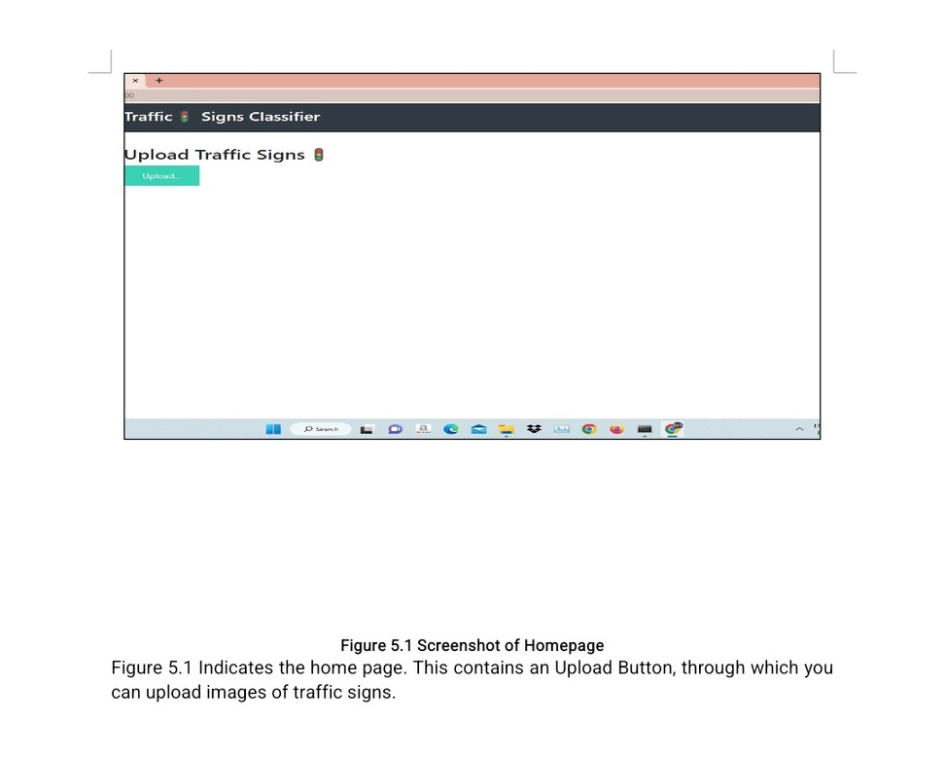

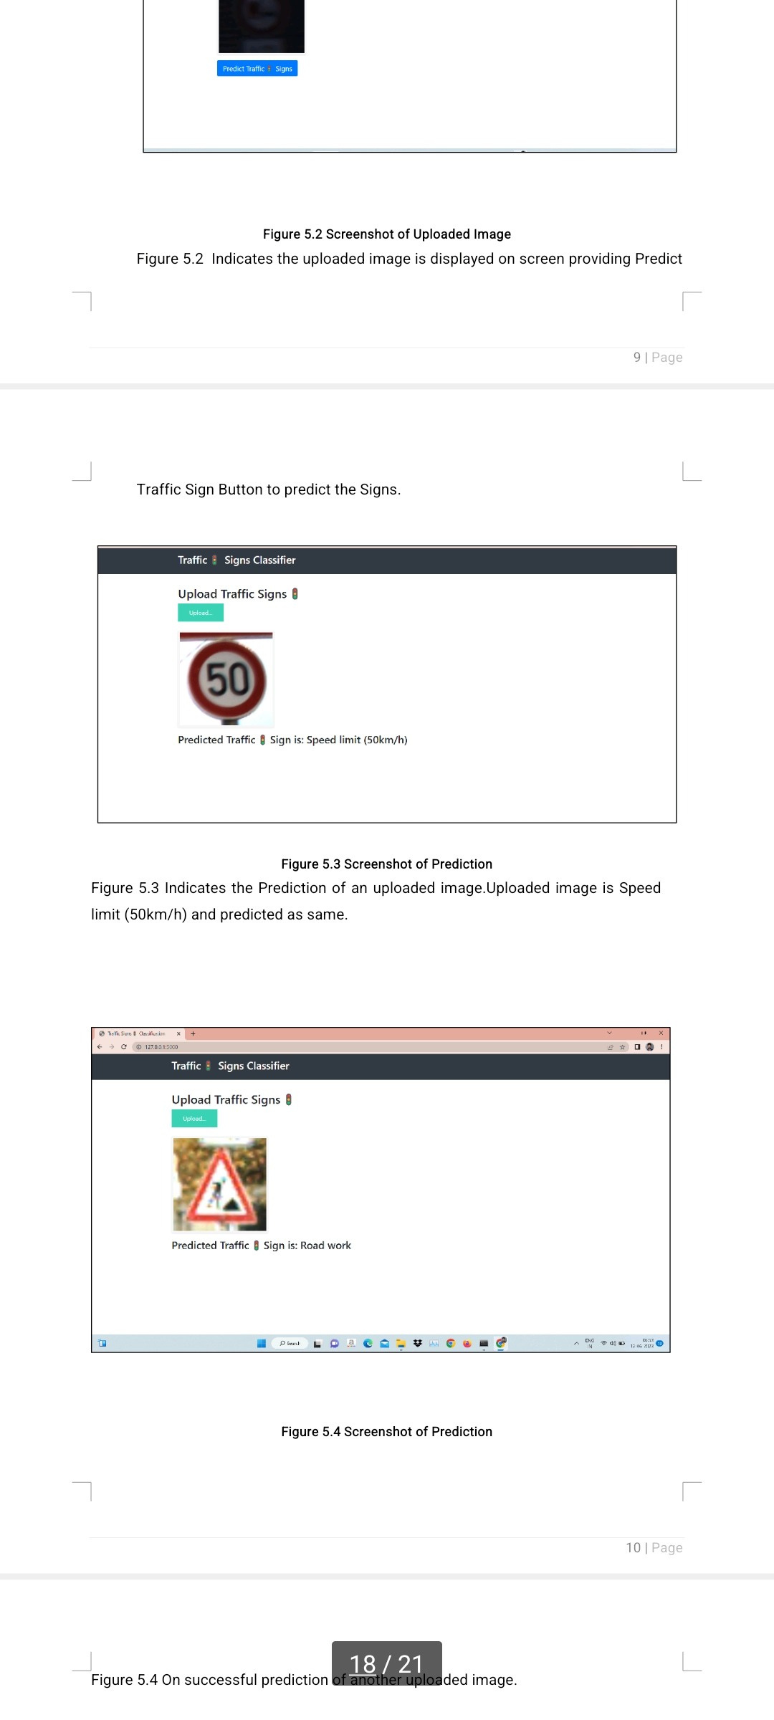
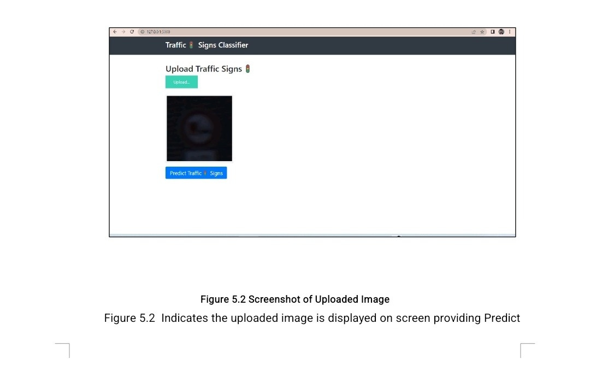



RESULT

Slide 9
ADVANTAGES
Cost-Effective: Implementing traffic sign detection through image processing can be cost- effective compared to other technologies.
Real-Time Processing: Image processing algorithms can analyze and process images in real-time.
Flexibility and Adaptability: Image processing algorithms can be designed to detect a wide range of traffic signs by leveraging various techniques such as edge detection, color analysis, pattern recognition, and machine learning.
Accuracy: Advanced image processing techniques, coupled with machine learning algorithms, can achieve high accuracy in traffic sign detection.
Scalability: Image processing-based traffic sign detection can be easily scaled to handle large amounts of data.

Slide 10
CONCLUSION
The goal of this project is to prove that a sign can be extracted from an image. traffic sign detection and recognition system for detecting the sign in a given image. The image analysis generally consists of three steps: detection, segmentation and classification . The sign is edge detected and segmentation applied to segregate the sign from background . This datasets include many types of complex traffic signs such as sign tilt, uneven lighting, traffic sign with distraction, and similar background colors. Through a variety of complex and difficult to distinguish traffic signs to verify the ability of the algorithm.
FUTURE SCOPE :
▪︎Integration in Autonomous Vehicle
▪︎Integration with Traffic Management System
▪︎Advanced Driver Assistance System(ADAS)
▪︎Pedestrian Safety

